Slide 1
Clo 02
Waves ch 16

Slide 2
Oscillations
Definition and Characteristics
An oscillation is a repetitive variation, typically in time, of some measure about a central value or between two or more different states. It is essentially a back-and-forth movement or fluctuation around an equilibrium point.
Localized: Oscillations are generally localized in space. The energy associated with the oscillation remains confined to the oscillating system.
Energy Transfer: While an oscillating system can exchange energy with its surroundings, the primary characteristic is the periodic exchange of potential and kinetic energy within the system itself.
Examples: A pendulum swinging, a mass attached to a spring bouncing up and down, and the vibration of a tuning fork are all examples of oscillations.

Slide 3
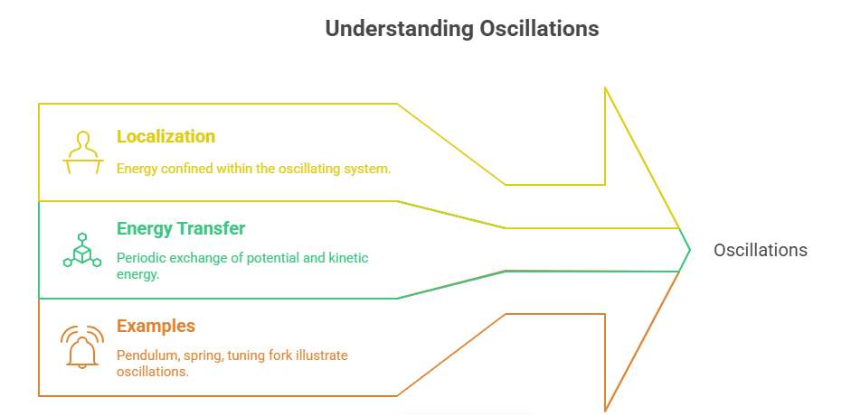
Oscillations

Slide 4
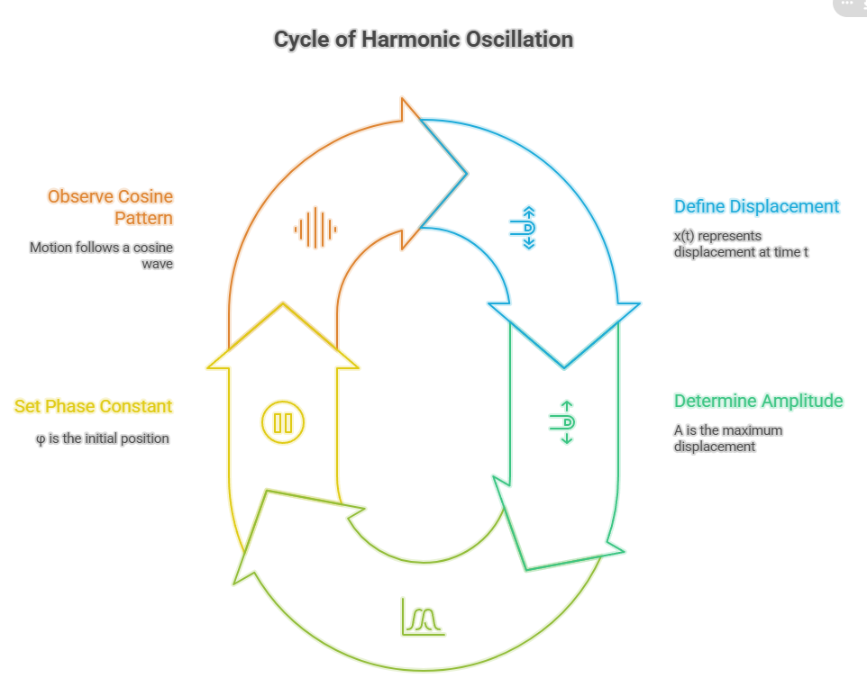

Slide 5
Waves
Definition and Characteristics
A wave is a disturbance that propagates through space and time, transferring energy from one point to another without the permanent displacement of the medium itself.
Propagation: Waves are characterized by their ability to travel or propagate through a medium (or even through a vacuum, in the case of electromagnetic waves).
Energy Transfer: The primary function of a wave is to transport energy. The medium through which the wave travels is disturbed, but it returns to its original state after the wave has passed.
Examples: Sound waves, light waves, water waves, and radio waves are all examples of waves.
Types of Waves
Transverse Waves: The displacement of the medium is perpendicular to the direction of wave propagation (e.g., light waves, water waves).
Longitudinal Waves: The displacement of the medium is parallel to the direction of wave propagation (e.g., sound waves).

Slide 6
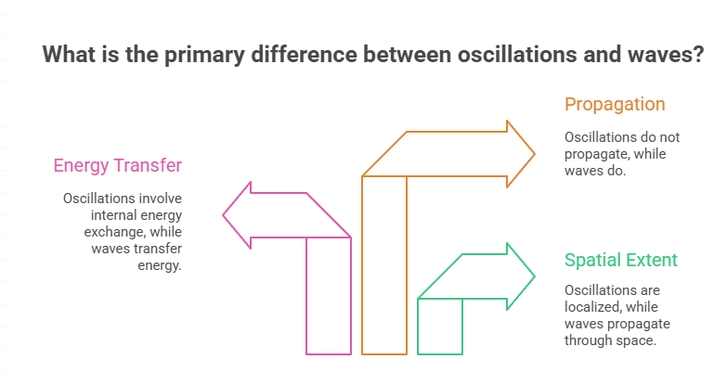
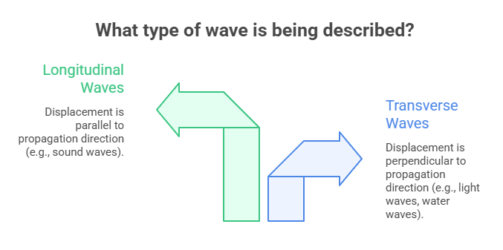

Slide 7
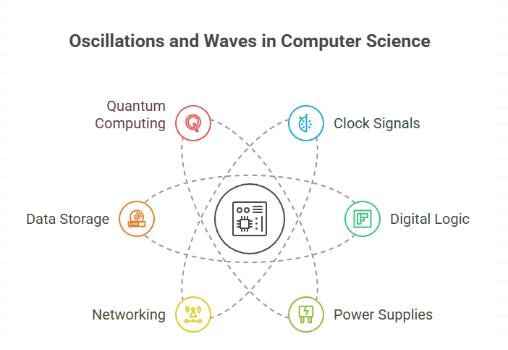
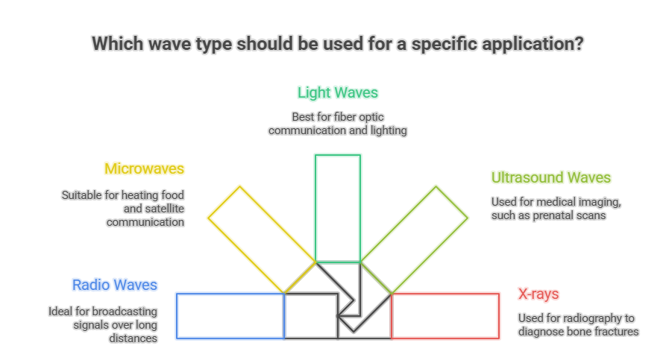

Slide 8
Travelling Waves
A travelling wave, also known as a propagating wave, is a disturbance that moves through a medium, transferring energy from one point to another without transferring matter. Imagine dropping a pebble into a still pond. The ripples that spread outwards are travelling waves.
Characteristics of Travelling Waves
Propagation: The most defining characteristic is their ability to move or propagate through space.
Energy Transfer: They transport energy away from the source of the disturbance.
Constant Amplitude: Ideally, the amplitude of a travelling wave remains constant as it propagates (in reality, damping effects can reduce the amplitude).
Wavelength (λ): The distance between two successive crests or troughs.
Frequency (f): The number of complete oscillations per unit time.
Velocity (v): The speed at which the wave propagates, related to wavelength and frequency by the equation: v = fλ.

Slide 9
Standing waves
Standing Waves
A standing wave, also known as a stationary wave, is a wave that remains in a constant position. It appears to oscillate in place without propagating. Standing waves are formed when two travelling waves of the same frequency and amplitude travel in opposite directions and interfere with each other.
Characteristics of Standing Waves
No Propagation: Unlike travelling waves, standing waves do not propagate energy. The energy is trapped within the wave.
Nodes and Antinodes: Standing waves exhibit specific points called nodes and antinodes.
  Nodes: Points where the amplitude is always zero.
  Antinodes: Points where the amplitude is maximum.
Fixed Boundaries: Standing waves are often formed in systems with fixed boundaries, such as a string fixed at both ends or an air column in a closed pipe.
Quantized Frequencies: Only certain frequencies, called resonant frequencies or harmonics, can produce stable standing waves in a given system.

Slide 10
Importance of waves
Applications
Both standing and travelling waves have numerous applications in science and engineering:
Travelling Waves: Communication systems (radio waves, microwaves), medical imaging (ultrasound), seismology (earthquake waves).
Standing Waves: Musical instruments, microwave ovens, optical resonators (lasers), structural analysis (identifying resonant frequencies to avoid structural damage).
Conclusion
Understanding the distinction between standing and travelling waves is crucial for comprehending a wide range of physical phenomena. While travelling waves transport energy through space, standing waves trap energy in a fixed location, creating distinct patterns of nodes and antinodes. Both types of waves play essential roles in various technological applications and scientific disciplines.

Slide 11
Sinusoidal waves
Simple & Smooth: Sine waves are continuous and easy to analyze mathematically.
Models Oscillations: They describe motion, sound, light, and AC signals.
Fourier Basis: All periodic signals can be built from sine waves.
Universal Tool: Used across physics, engineering, and computer science for clarity and learning.

Slide 12
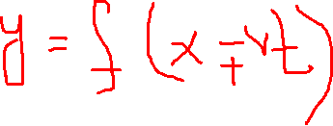
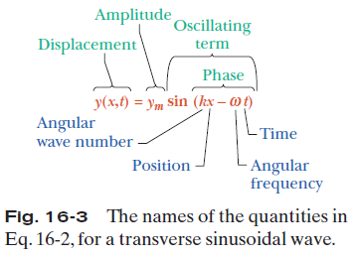
16.2 Wave Variables

Slide 13




16.2 Wave Variables
The amplitude y_{m} of a wave is the magnitude of the maximum displacement of the elements from their equilibrium positions as the
wave passes through them.
The phase of the wave is the argument (kx –ωt) of the sine function. As the wave sweeps through a string element at a particular position x, the phase changes linearly with time t.
The wavelength λ of a wave is the distance parallel to the direction of the wave’s
travel between repetitions of the shape of the wave (or wave shape). It is related to the angular wave number, k, by
:
The period of oscillation T of a wave is the time for an element to move through one full oscillation. It is related to the angular frequency, ω, by
The frequency f of a wave is defined as 1/T and is related to the angular frequency ω by
A phase constant φ in the wave function:
y =y_{m} sin(kx –ωt+ φ). The value of φ can be chosen so that the function gives some other displacement and slope at x = 0 when t = 0.

Slide 14
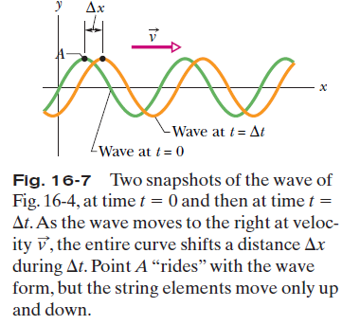

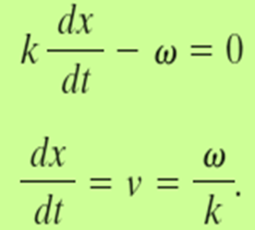
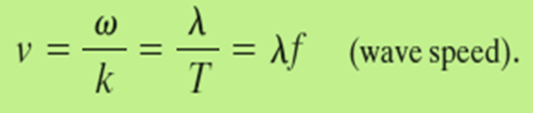
16.3 The Speed of a Traveling Wave

Slide 15
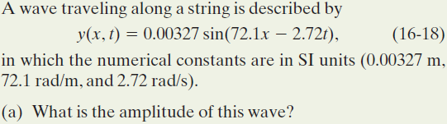
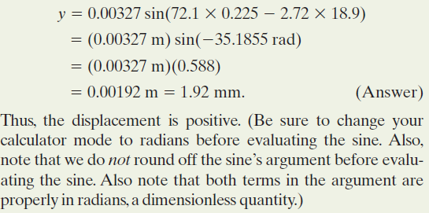
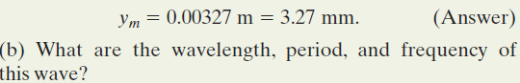
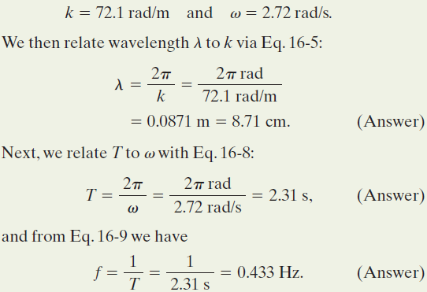

Example, Transverse Wave

Slide 16
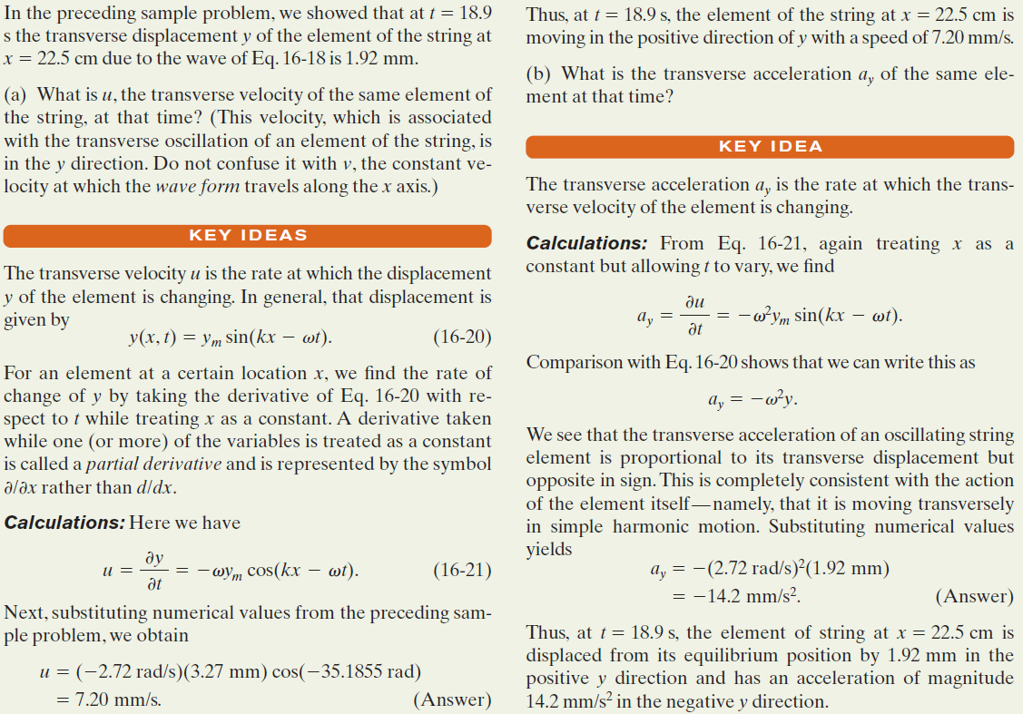
Example, Transverse Wave, Transverse Velocity, and Acceleration

Slide 17
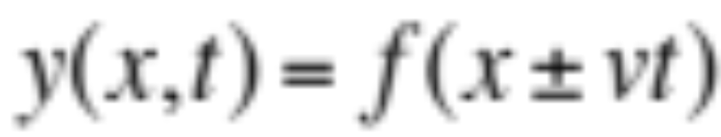
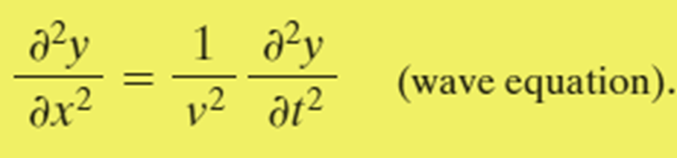
16.6 The Wave Equation
A travelling wave is always in the following form:
Such functions are solutions of the wave equation:
# It is a linear partial differential equation; when y₁ and y₂ are solutions, any linear combination of y₁ and y₂ (like ay₁+by₂) is also a solution.

Slide 18
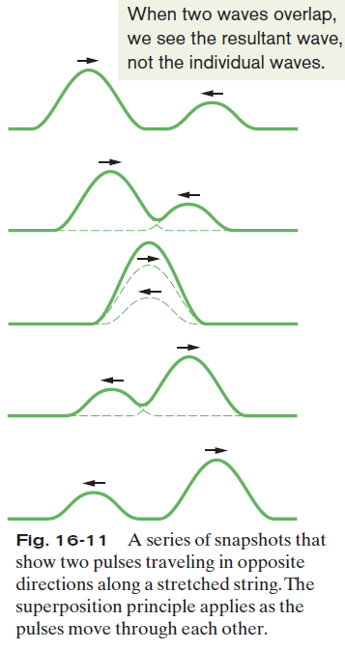

16.7 The Superposition of Waves
Overlapping waves algebraically add to produce a resultant wave (or net wave).
Overlapping waves do not in any way alter the travel of each other.
They interfere but do not interact.
# The principle of linear superposition is valid only when the amplitude is small.

Slide 19



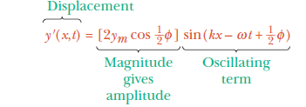
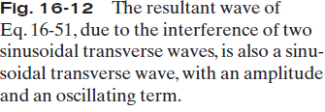
16.8 Interference of Waves
If two sinusoidal waves of the same amplitude and wavelength travel in the same direction along a stretched string, they interfere to produce a resultant sinusoidal wave traveling in that direction.

Slide 20
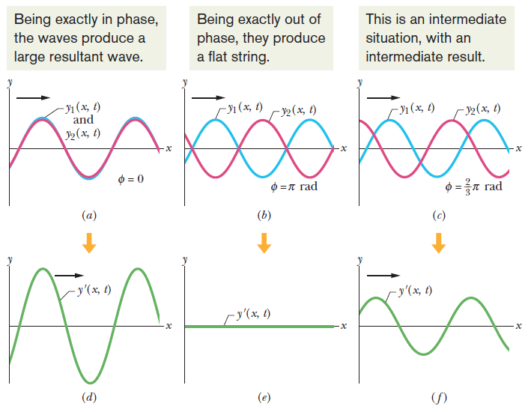
16.8 Interference of Waves

Slide 21
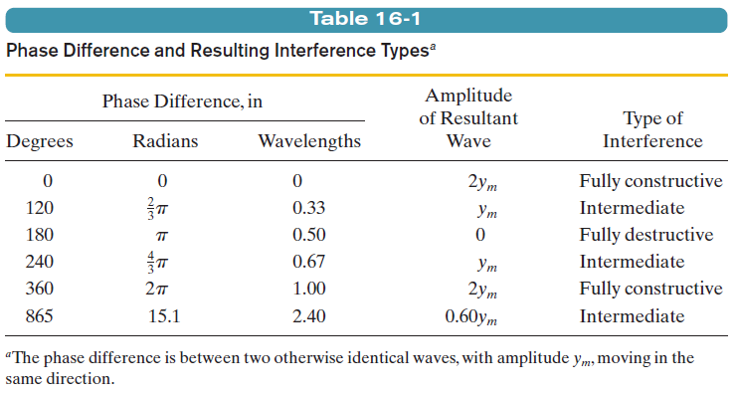
16.8 Interference of Waves

Slide 22
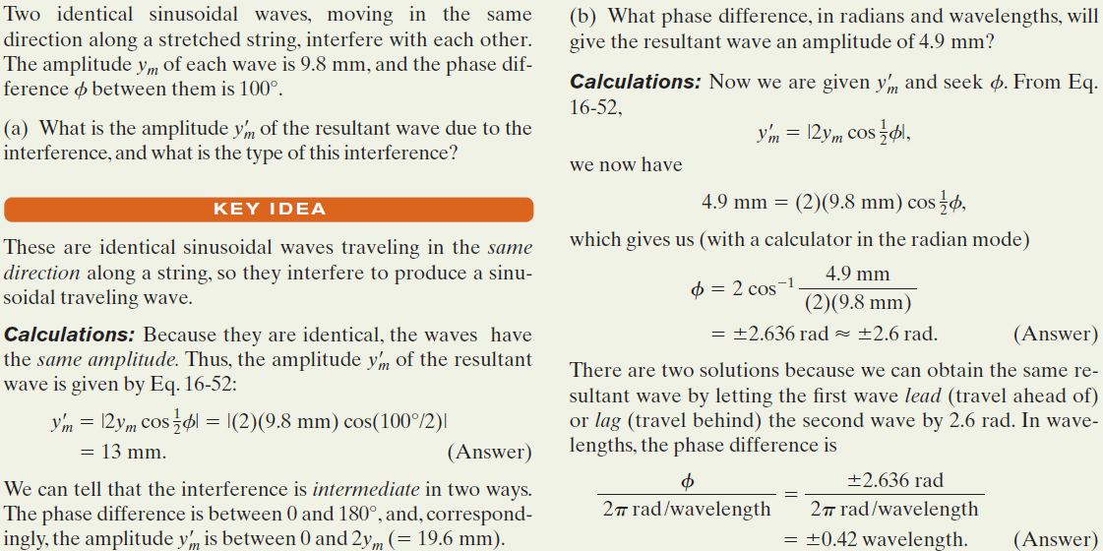
Example, Transverse Wave:

Slide 23
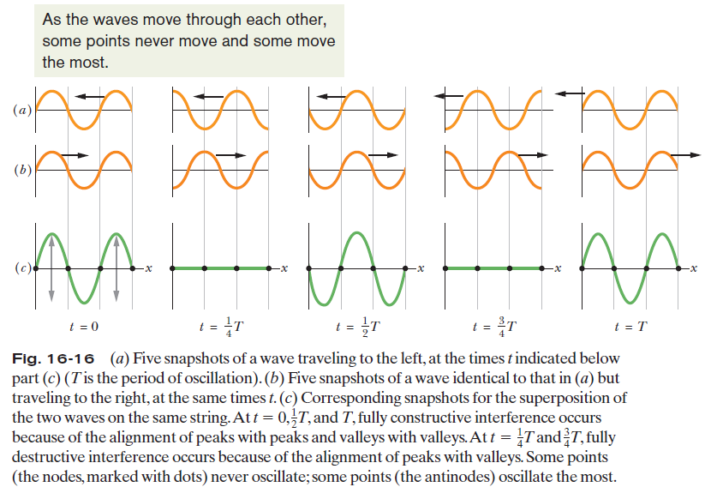
16.9: Standing Waves

Slide 24

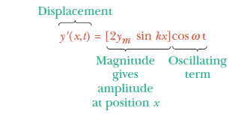
16.9: Standing Waves
If two sinusoidal waves of the same amplitude and wavelength travel in opposite directions along a stretched string, their interference with each other produces a standing wave.

Slide 25
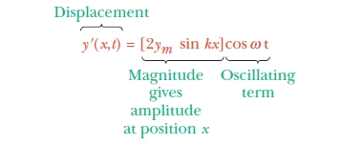
16.9: Standing Waves
The amplitude is zero when kx =nπ, for n =0,1,2, . . . .
Since k =2π/λ, we get x = n λ/2, for n =0,1,2, . . . (nodes),
as the positions of zero amplitude or the nodes.
The amplitude has a maximum value of 2y_{m} when
kx = 1/2π, 3/2π, 5/2π, . . .=(n+1/2) π, for n =0,1,2, . . . .
That is, x = (n+1/2) λ/2, for n 0,1,2, . . . (antinodes),
as the positions of maximum amplitude or the antinodes.

Slide 26
Problem solving
Super position principle

Slide 27
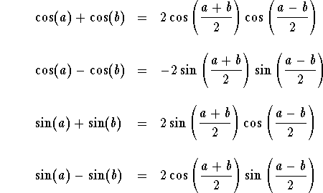
Formulas to be used

Slide 28
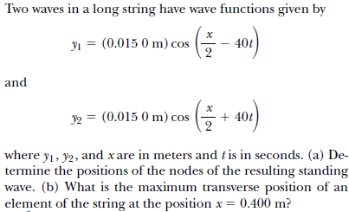
Problem 1

Slide 29
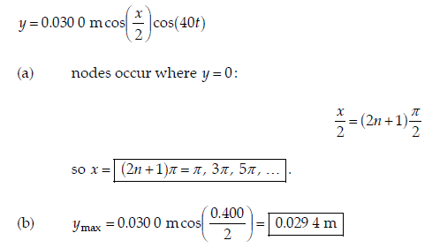
Solution problem 1

Slide 30
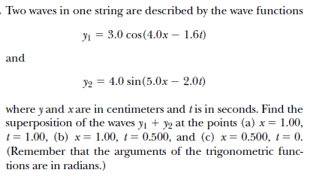
Problem 2

Slide 31
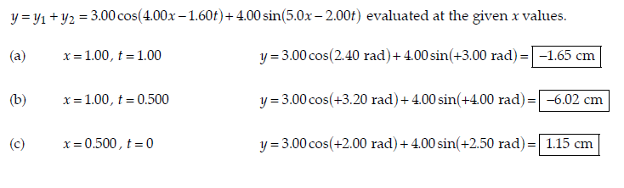
Solution problem 2

Slide 32
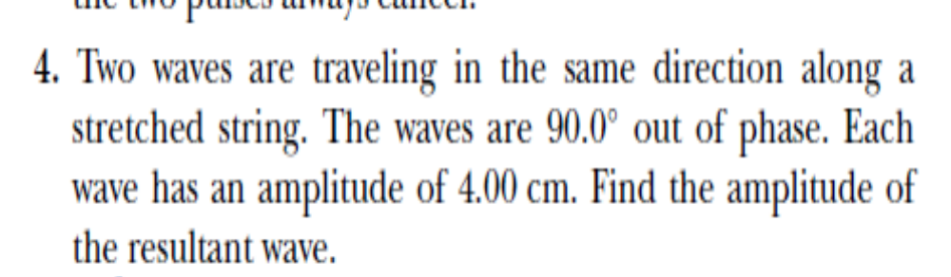
Problem 3

Slide 33
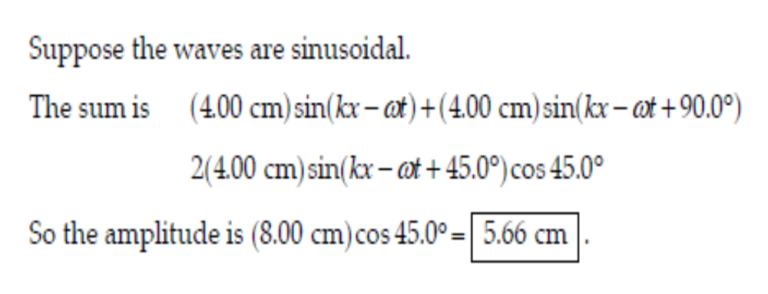
Solution problem 3

Slide 34
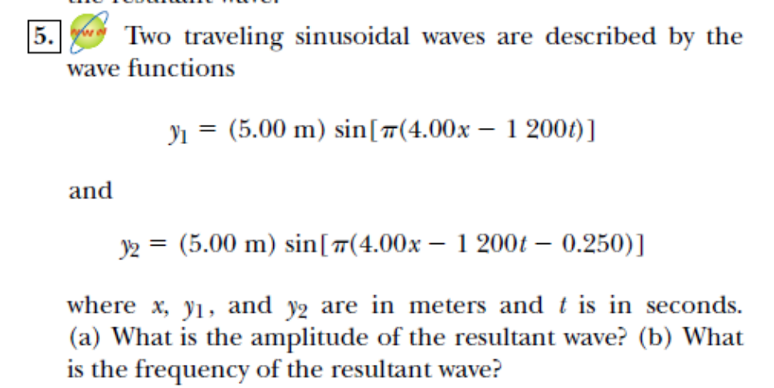
Problem 4

Slide 35
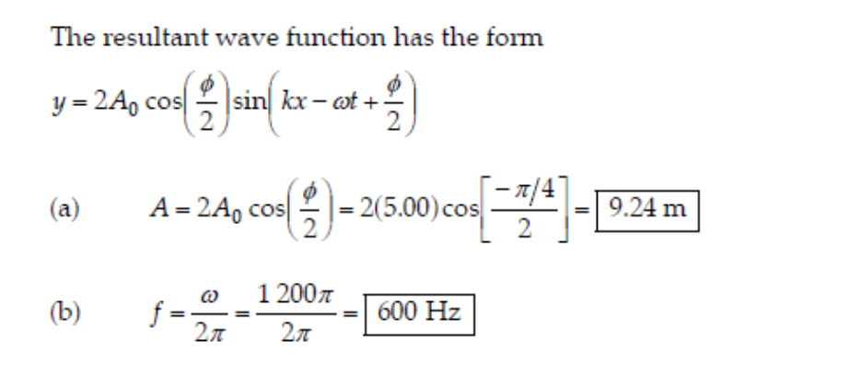
Solution problem4

Slide 36
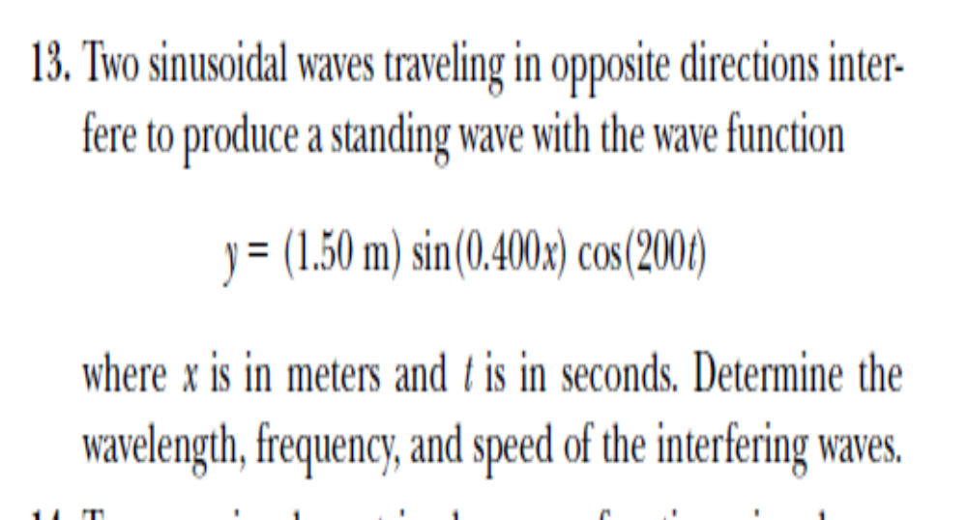

Problem 5

Slide 37
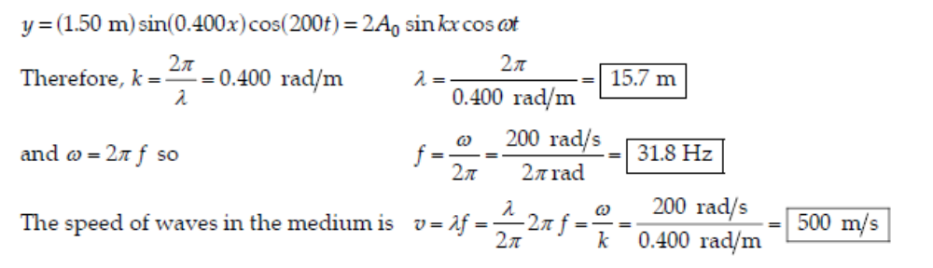
Solution problem5

Slide 38
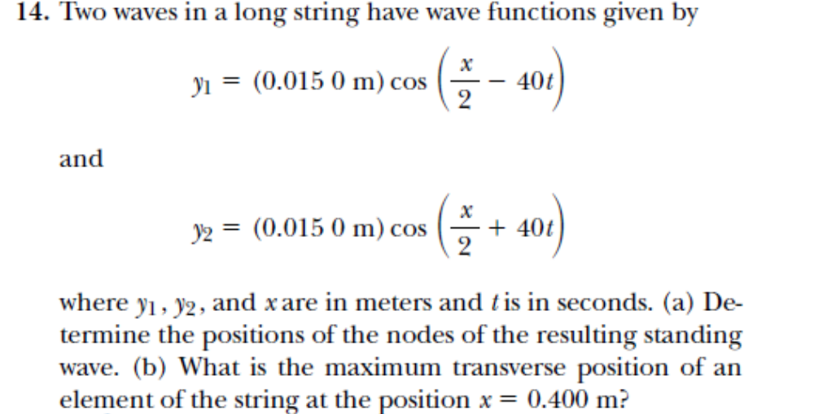
Problem 6

Slide 39
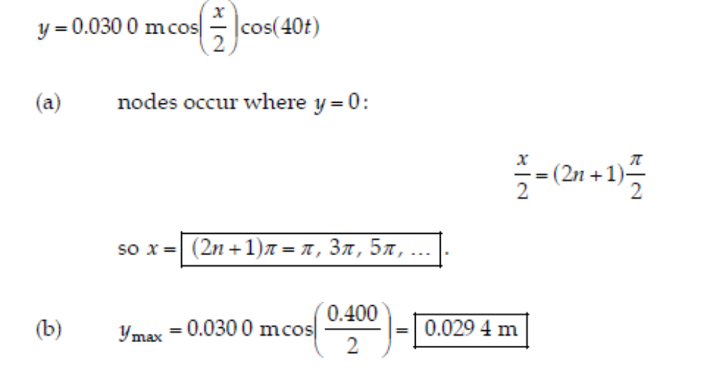
Solution problem 6

